Slide 1
Competitive Cyber Security Organization
HackPSU Workshop – Tracking Some Hacking

Slide 2

Who we are / What we Do
Mentor
Teach a variety of cybersecurity topics
Empower students with technical and non-technical skills
Hands-on time to practice
Foster self-learning and continual improvement
Cultivate community of talented individuals
Compete
Represent Penn State in cyber competitions
Travel to competitions and conferences
Network and build your resume
Discord
Psuccso.org
Notes:
Josh

Slide 3
Learning Objectives:
SIEM Basics
Identify Suspicious Activity
Hands-On Experience

Slide 4
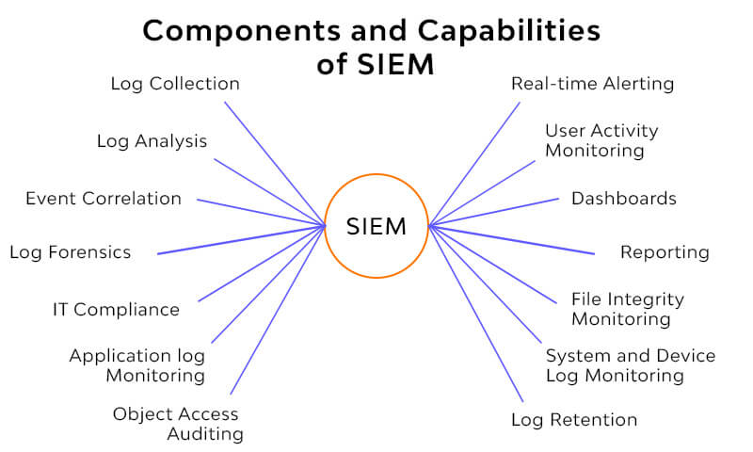
What is a SIEM?
tool to gather data into a central location for easy analysis
“Data” includes logs, events from EDR and IDS systems, and system activities

Slide 5
Why do we use it?
See data from multiple logs on multiple devices
A bird’s eye view of the network for easy DFIR
Alerting based on events for quick reactions

Slide 6
Intro to ELK Stack
Elasticsearch – The log analytics and search engine that is used to filter through and analyze logs
Kibana – The dashboard software that allows us to visualize data in a clean and easily understandable manner
Additional tools – Logstash, Beats, etc.

Slide 7
Walkthrough
Go to https://kibana-hackpsu.psuccso.org/
Cred:
Username: guest
Password: cNKKb2L2kNMprJp

Slide 8
Airport Data Questions:
Who is the most common Carrier?
How many flights do they have?
What is the median ticket price of a canceled flight?
What about the average? (visualize)
Where were most of the planes going?
What day had the most air travel?
Taylor Swift's private jets ran out of fuel and she needs to get from her show in Bogota to a Chiefs game in Kansas City in the next week. If the flight plan for next week is the same as this week what flight number is she taking?
If she then has to travel from KC to Melbourne, what flights can she take? Assume the flight leaves at the time of the timestamp.

Slide 9
One Possible Answer
KC to London: Flight 8FYLDGE
London to Manchester: Flight DY71DZR
Manchester to Melbourne: Flight 09QLEMN
Final time: Oct 7, 2024 @ 15:37:38.000

Slide 10
Apply it to Cyber
What if instead of airports these were IP addresses?
What if instead of Carrier type it was system events?

Slide 11
Questions:
Q1: What webmail service is access?
Q2: What IP address attempts to exploit fp30reg.dll?
Q3: What was the attacker attempting to do?
Q4: What CVE does this attack relate to?
Q5: What is the other dll that was requested?
Q6: What suspicous activity did 222.134.69.86 do?
Q7: Were any of these attacks successful?

